Slide 1
Cloud Infrastructure Mechanisms
Karthikeyan S

Slide 2
Topics
Network Perimeter
Virtual Server,
Cloud Storage Device,
Cloud Usage Monitor,
Resource Replication.

Slide 3
Cloud Storage Device
The cloud storage device mechanism represents storage devices that are designed specifically for cloud-based provisioning.
Instances of these devices can be virtualized, similar to how physical servers can spawn virtual server images.
Cloud storage devices are commonly able to provide fixed increment capacity allocation in support of the pay-per-use mechanism.
Cloud storage devices can be exposed for remote access via cloud storage services.

Slide 4
A primary concern related to cloud storage is the security, integrity, and confidentiality of data, which becomes more prone to being compromised when entrusted to external cloud providers and other third parties.
Another issue applies specifically to the performance of large databases.

Slide 5
Cloud Storage Levels
Cloud storage device mechanisms provide common logical units of data storage, such as:
Files – Collections of data are grouped into files that are located in folders.
Blocks – The lowest level of storage and the closest to the hardware, a block is the smallest unit of data that is still individually accessible.
Datasets – Sets of data are organized into a table-based, delimited, or record format.
Objects – Data and its associated metadata are organized as Web-based resources.

Slide 6
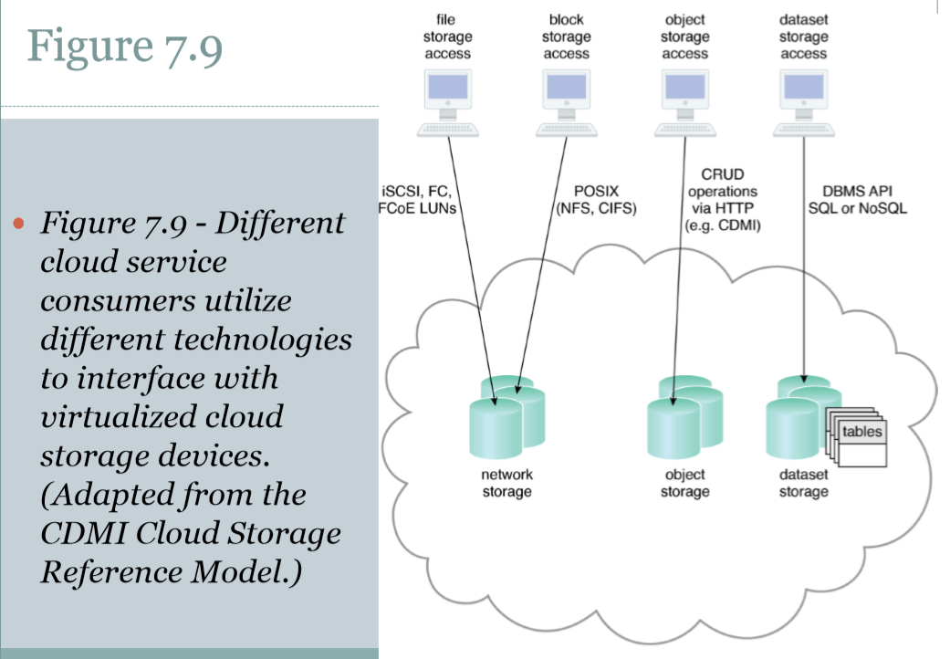
Each of these data storage levels is commonly associated with a certain type of technical interface which corresponds to a particular type of cloud storage device and used to expose its API.

Slide 7
According to different storage levels, there are three kinds of interfaces implemented:
Network storage interfaces – files or blocks
Object storage interfaces – web resources
Database storage interfaces – relational or nonrelational (NoSQL)

Slide 8
Network Storage Interfaces
Legacy network storage most commonly falls under the category of network storage interfaces. Typically refers to a network that is not based on the IP (TCP/IP) protocol. IPX, SNA, AppleTalk and DECnet are examples of legacy networks. See legacy LAN, IP network and IP on Everything.
It includes storage devices in compliance with industry standard protocols, such as SCSI for storage blocks and the server message block (SMB), common Internet file system (CIFS), and network file system (NFS) for file and network storage.
File storage entails storing individual data in separate files that can be different sizes and formats and organized into folders and subfolders. Original files are often replaced by the new files that are created when data has been modified.
When a cloud storage device mechanism is based on this type of interface, its data searching and extraction performance will tend to be suboptimal.
Storage processing levels and thresholds for file allocation are usually determined by the file system itself. Block storage requires data to be in a fixed format (known as a data block), which is the smallest unit that can be stored and accessed and the storage format closest to hardware. Using either the logical unit number (LUN) or virtual volume block-level storage will typically have better performance than file-level storage.

Slide 9
Object Storage Interfaces
Various types of data can be referenced and stored as Web resources. This is referred to as object storage, which is based on technologies that can support a range of data and media types.
Cloud Storage Device mechanisms that implement this interface can typically be accessed via REST or Web service-based cloud services using HTTP as the prime protocol. The Storage Networking Industry Association’s Cloud Data Management Interface (SNIA’s CDMI) supports the use of object storage interfaces.

Slide 10
Database Storage Interfaces
Cloud storage device mechanisms based on database storage interfaces typically support a query language in addition to basic storage operations. Storage management is carried out using a standard API or an administrative user-interface.
This classification of storage interface is divided into two main categories according to storage structure, as follows.
Relational Data Storage (SQL)
Non-Relational Data Storage(NOSQL)

Slide 11
Relational Data Storage
Traditionally, many on-premise IT environments store data using relational databases or relational database management systems (RDBMSs). Relational databases (or relational storage devices) rely on tables to organize similar data into rows and columns. Tables can have relationships with each other to give the data increased structure, to protect data integrity, and to avoid data redundancy (which is referred to as data normalization). Working with relational storage commonly involves the use of the industry standard Structured Query Language (SQL).
A cloud storage device mechanism implemented using relational data storage could be based on any number of commercially available database products, such as IBM DB2, Oracle Database, Microsoft SQL Server, and MySQL.
Challenges with cloud-based relational databases commonly pertain to scaling and performance. Scaling a relational cloud storage device vertically can be more complex and cost-ineffective than horizontal scaling. Databases with complex relationships and/or containing large volumes of data can be afflicted with higher processing overhead and latency, especially when accessed remotely via cloud services.

Slide 12
Non Relational Data Storage
Non-relational storage (also commonly referred to as NoSQL storage) moves away from the traditional relational database model in that it establishes a “looser” structure for stored data with less emphasis on defining relationships and realizing data normalization. The primary motivation for using non-relational storage is to avoid the potential complexity and processing overhead that can be imposed by relational databases. Also, non-relational storage can be more horizontally scalable than relational storage.
The trade-off with non-relational storage is that the data loses much of the native form and validation due to limited or primitive schemas or data models. Furthermore, non-relational repositories don’t tend to support relational database functions, such as transactions or joins. Normalized data exported into a non-relational storage repository will usually become denormalized, meaning that the size of the data will typically grow. An extent of normalization can be preserved, but usually not for complex relationships. Cloud providers often offer non-relational storage that provides scalability and availability of stored data over multiple server environments. However, many non-relational storage mechanisms are proprietary and therefore can severely limit data portability.

Slide 13
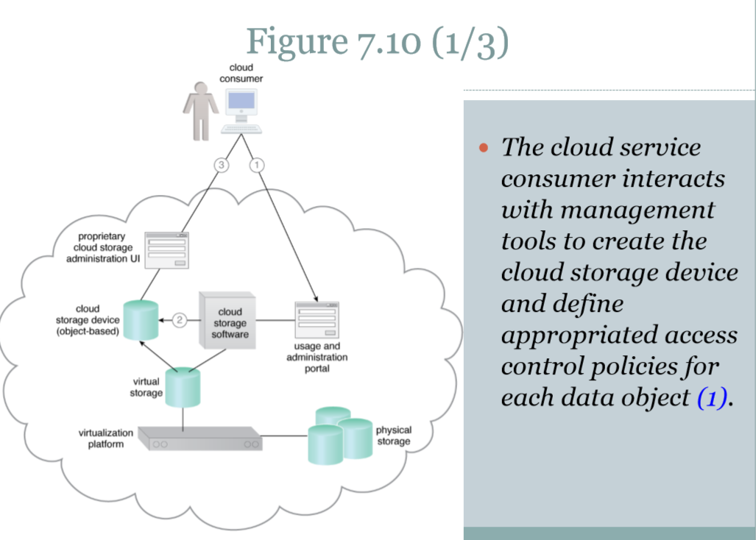

Slide 14
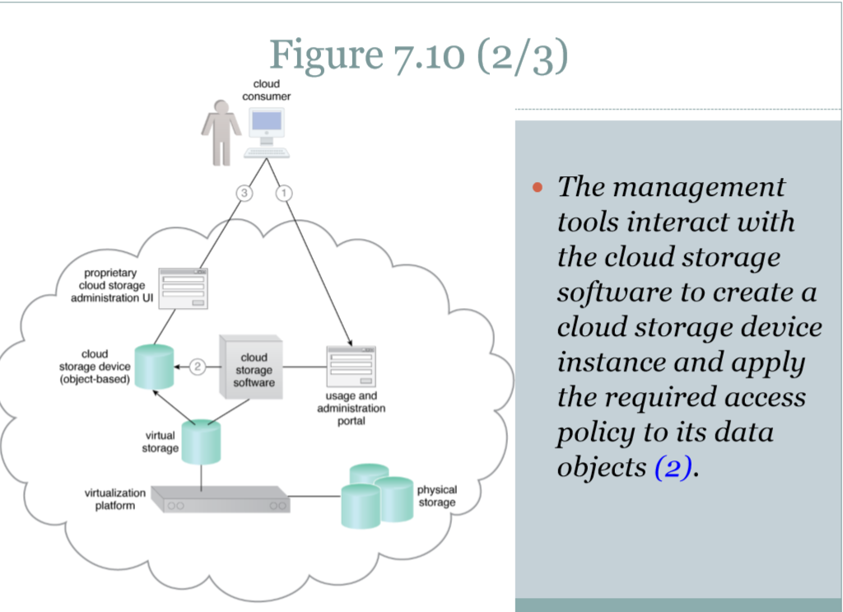

Slide 15
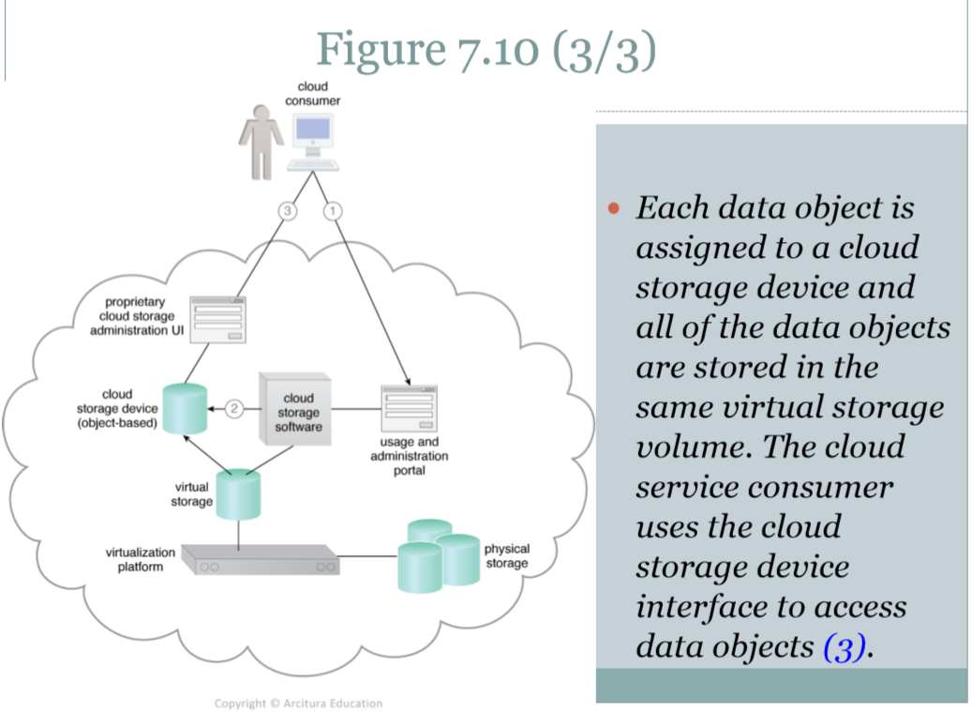

Slide 16
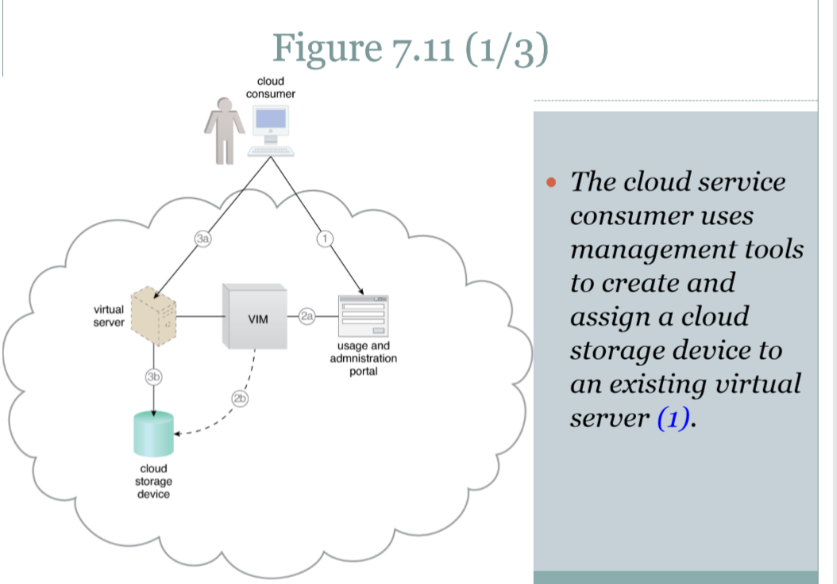

Slide 17
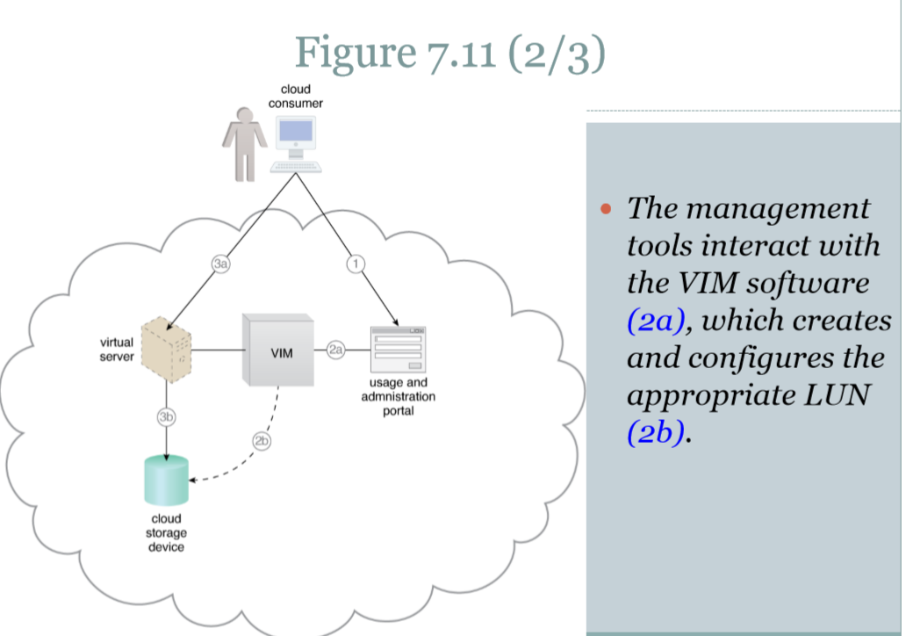

Slide 18
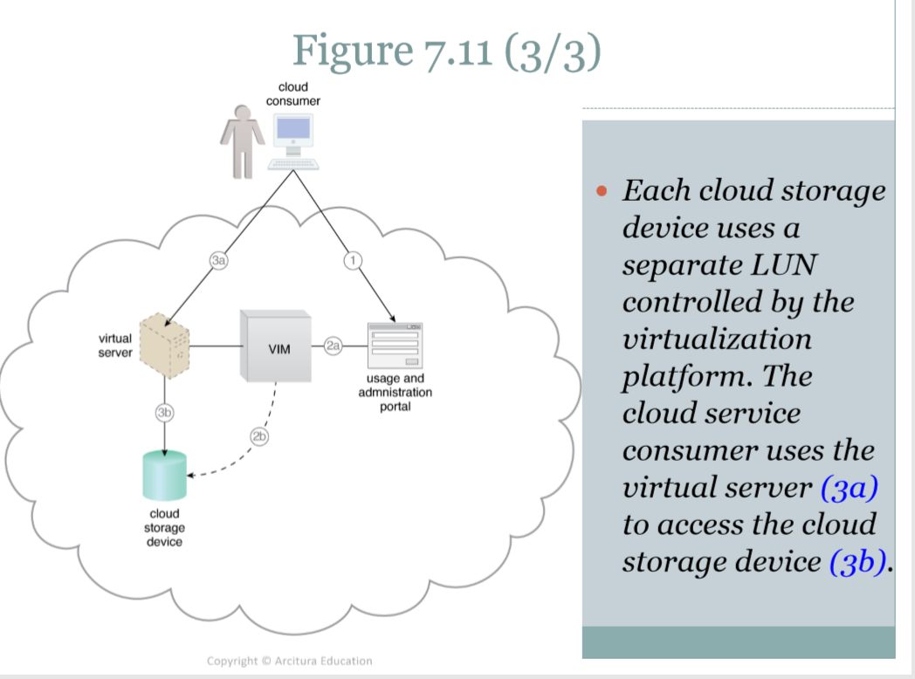

Slide 19
Summary of Key Points
•

